Slide 1
GRADUATION PROJECT
Clicks Loyalty Analytics
And Machine Learning System
CLICKS LOYALTY
Customer Analytics System
DONE BY
Faisal Abidy
Armen Balian
Mohammed Al Kouz
01

Slide 2
CLICKS LOYALTY ANALYTICS
Project Outline
The presentation follows the same logic as the analytics system: clean the data, engineer the score, compare models, and translate the output into business actions.
Data Foundation
Customer records are standardized, validated, and checked for duplicates before analysis.
01
Feature Engineering
Raw columns are transformed into age, membership duration, logarithmic points, and points velocity.
02
Loyalty Scoring
A weighted ranking formula converts behavior into a single loyalty score and ordered customer rank.
03
Segmentation & Clustering
Customers are grouped into practical loyalty tiers and unsupervised behavioral clusters.
04
Modeling & Decisions
Classification and regression models are evaluated, then converted into campaign recommendations.
05
The aim is not only to get a high model score, but to create a defensible customer analytics process that a business team can understand and repeat.
Clicks Loyalty Customer Analytics System
02

Slide 3
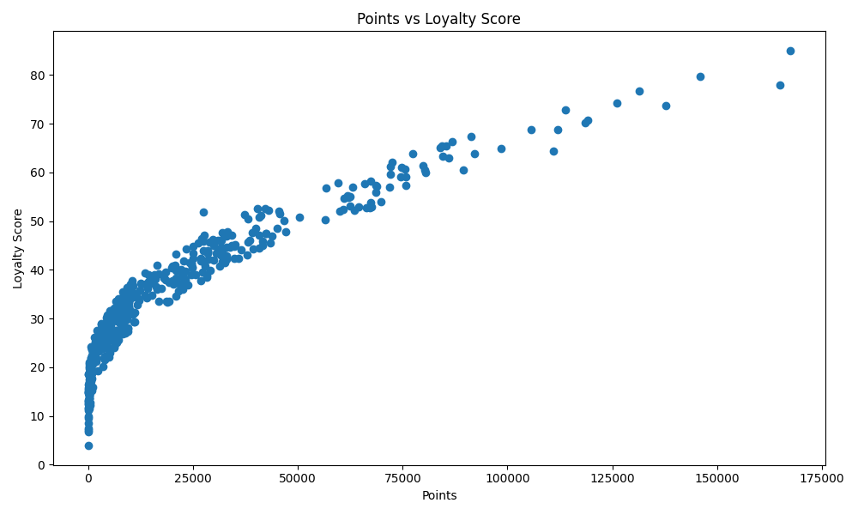
CLICKS LOYALTY ANALYTICS
Clicks Loyalty Analytics
A machine learning system for ranking members, identifying loyalty segments, and supporting targeted customer decisions.
The project turns raw loyalty records into an explainable scoring, segmentation, clustering, and model comparison workflow.
446
91.0%
91.2%
clean customer records
best test accuracy
best weighted F1 score
Figure 1. Points and loyalty score relationship
The strongest model is Gradient Boosting, selected because it delivered the highest accuracy, balanced accuracy, and F1 score across the tested classifiers.
Clicks Loyalty Customer Analytics System
01

Slide 4
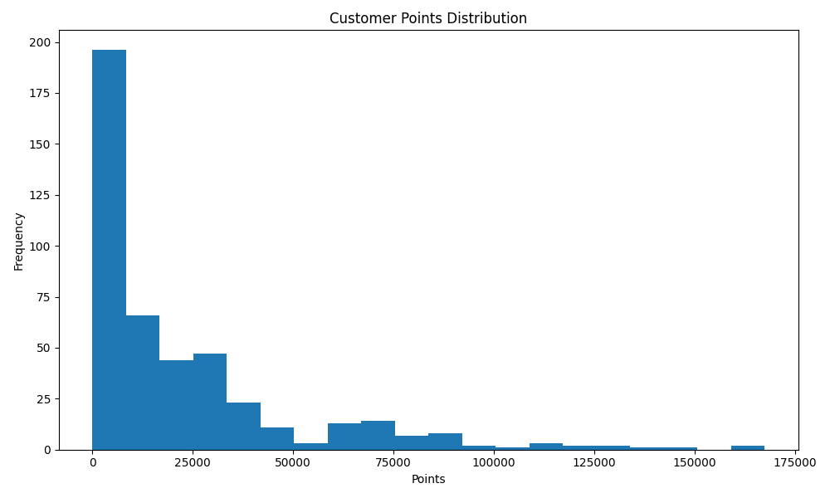
CLICKS LOYALTY ANALYTICS
Dataset Foundation
446
0
5
rows after duplicate removal
duplicates removed
core dataset columns
Figure 2. Distribution of customer points
The point distribution is intentionally uneven because real retail loyalty programs usually have many low-to-mid activity members and a smaller group of very high value members.
Clicks Loyalty Customer Analytics System
03

Slide 5
CLICKS LOYALTY ANALYTICS
Analytics Pipeline
The code follows a repeatable pipeline so every output can be traced back to a specific preparation, feature, and modeling step.
Customer CSV
>
Features
>
Segments
>
load required columns
age, duration, points velocity
loyalty tiers and KMeans clusters
Cleaning
>
Score & Rank
>
Models
dates, text, points, duplicates
weighted loyalty formula
classification and regression outputs
This structure matters because loyalty ranking can easily become subjective. The pipeline makes the process explicit: raw member behavior becomes measurable features, the features become a score, and the score becomes a segment that can be modeled and acted on.
Clicks Loyalty Customer Analytics System
04

Slide 6
CLICKS LOYALTY ANALYTICS
Loyalty Score and Ranking
The score combines total value, activity intensity, membership duration, and percentile position into one explainable customer ranking.
35%
20%
20%
15%
10%
Points
Log Points
Percentile Rank
Points / Day
Membership Days
The ranking system sorts customers by Loyalty Score in descending order. Rank 1 is the strongest customer because the score captures both high point totals and sustained engagement.
Why this formula was picked
Points carry the largest weight because they represent direct loyalty value. Log Points and Percentile Rank reduce distortion from very large point balances. Points per day rewards recent intensity, while membership days keeps long-term consistency visible.
Figure 3. Loyalty score increases with points, but not only points
Clicks Loyalty Customer Analytics System
05

Slide 7
CLICKS LOYALTY ANALYTICS
What the Segments Mean
Each loyalty segment should lead to a different business treatment: protection, growth, conversion, or reactivation.
Most Loyal
90 members
67,855 avg points
Protect with VIP service, early access, and high-value recognition.
Highly Active
89 members
26,942 avg points
Increase basket size with bundles, premium categories, and milestone rewards.
Active
89 members
10,964 avg points
Keep engagement steady with monthly challenges and personalized reminders.
Potential
89 members
4,603 avg points
Push progression with starter missions, point multipliers, and onboarding messages.
Least Loyal
88 members
497 avg points
Use low-risk reactivation offers and measure response before spending heavily.
Inactive
1 members
0 avg points
Send a focused win-back message, then monitor whether the member returns.
The labels are intentionally simple so non-technical stakeholders can use the result in campaign planning without reading the model code.
Clicks Loyalty Customer Analytics System
06

Slide 8
CLICKS LOYALTY ANALYTICS
Segment Summary Metrics
The final segments are balanced across most active groups, while value differs sharply between the lower and upper loyalty tiers.
Segment
Members
Avg Points
Avg Score
Average Points
Most Loyal
90
67,855
57.0
Most Loyal
67,855
Highly Active
89
26,942
41.7
Highly Active
26,942
Active
89
10,964
33.6
Active
10,964
Potential
89
4,603
25.9
Least Loyal
88
497
16.4
Potential
4,603
Inactive
1
0
7.1
Least Loyal
497
Inactive
0
Most Loyal customers are not only slightly ahead; their average points are far above every other segment.
Clicks Loyalty Customer Analytics System
07

Slide 9
CLICKS LOYALTY ANALYTICS
Behavioral Clustering
KMeans adds a second view of the members by grouping similar behavior patterns without using the loyalty segment labels.
Cluster 0
Cluster 1
Cluster 2
Cluster 3
186 members
82 members
133 members
45 members
11,476 avg points
37,813 avg points
5,773 avg points
87,354 avg points
32.5 avg score
332 avg membership days
43.8 avg score
110 avg membership days
23.3 avg score
149 avg membership days
63.4 avg score
316 avg membership days
Cluster 3 is small but highly valuable
It contains only 45 members, yet it has the highest average points and loyalty score. This makes it a priority group for retention and premium treatment.
Clicks Loyalty Customer Analytics System
08

Slide 10
CLICKS LOYALTY ANALYTICS
Cluster Interpretation
The clusters help separate high-value loyal members from newer high-activity members and broad mid-value populations.
Cluster 0
large steady base
Largest group, moderate score, long membership duration.
Cluster 1
new high activity
Shorter membership duration but strong point balances.
Cluster 2
developing members
Mid-size group with low-to-mid points and lower average score.
Cluster 3
premium loyal core
Smallest group with the highest points and strongest score.
How to use clusters
Use clusters as a second lens after loyalty segments. Segments are easier for campaigns, while clusters reveal behavior patterns behind the labels.
Clicks Loyalty Customer Analytics System
09

Slide 11
CLICKS LOYALTY ANALYTICS
Train and Test Split Selection
Three split ratios were tested to check whether the model result stays strong when the training and testing balance changes.
Split
Accuracy
Balanced
F1
Macro F1
Why 70/30 is used in the final run
70/30
91.0%
89.9%
91.2%
89.5%
The 70/30 split gives the largest test set among the three experiments and still delivers the best overall Gradient Boosting performance. That makes the evaluation more convincing for a small educational dataset.
75/25
89.3%
87.8%
89.4%
87.3%
80/20
88.9%
85.6%
89.1%
85.4%
70/30
75/25
80/20
91.2% weighted F1
89.4% weighted F1
89.1% weighted F1
Clicks Loyalty Customer Analytics System
10

Slide 12
CLICKS LOYALTY ANALYTICS
Classification Model Comparison
Three classifiers were evaluated on the same engineered features and target segments. Gradient Boosting is the strongest choice.
Weighted F1 Score
1. Gradient Boosting
Gradient Boosting
91.2%
Best overall result: 91.0% accuracy, 89.9% balanced accuracy, and 91.2% weighted F1 on the 70/30 split.
Random Forest
88.2%
Decision Tree
81.1%
2. Random Forest
Strong second model with stable performance, but it remains below Gradient Boosting across the final comparison metrics.
Balanced Accuracy
Gradient Boosting
89.9%
3. Decision Tree
Random Forest
87.0%
Most interpretable baseline, but lower performance shows a single shallow tree is too simple for the behavior patterns.
Decision Tree
78.6%
Clicks Loyalty Customer Analytics System
11

Slide 13
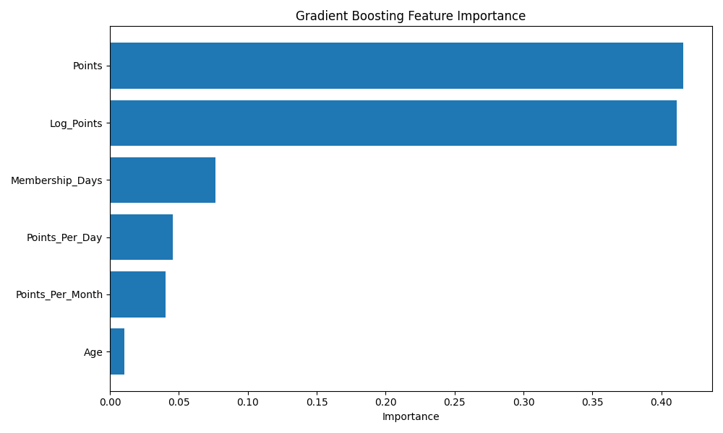
CLICKS LOYALTY ANALYTICS
Why Gradient Boosting Works Here
Gradient Boosting is well suited to this dataset because loyalty behavior is not purely linear: points, point velocity, age, and membership duration interact.
Feature Importance Ranking
Points
41.6%
Log Points
41.1%
Membership Days
7.7%
Points / Day
4.6%
Points / Month
4.0%
Age
1.0%
Figure 5. Gradient Boosting feature importance
Points and Log Points dominate the model, which is expected in a loyalty system. Membership duration and spending velocity still matter because they help separate steady customers from recent high-point customers.
Clicks Loyalty Customer Analytics System
12

Slide 14
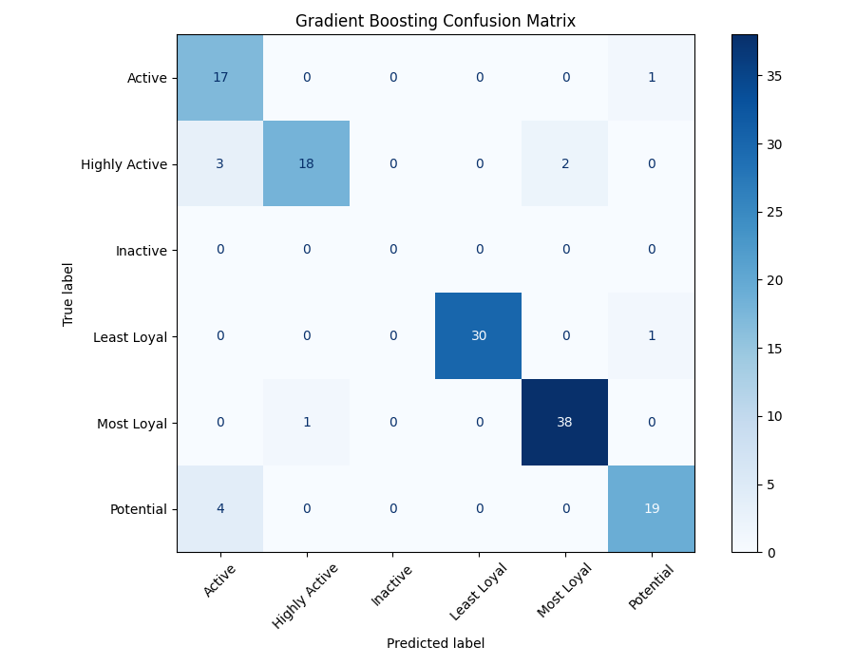
CLICKS LOYALTY ANALYTICS
Model Evaluation Detail
The final evaluation uses multiple classification metrics so the model is not judged by accuracy alone.
91.0%
89.9%
92.1%
accuracy
balanced accuracy
precision
91.0%
91.2%
89.5%
recall
weighted F1
macro F1
Balanced metrics matter
Balanced Accuracy and Macro F1 are included because the segments are not exactly identical in behavior. These metrics reduce the risk of picking a model that performs well only on the easiest or largest categories.
Figure 6. Gradient Boosting confusion matrix
Clicks Loyalty Customer Analytics System
13

Slide 15
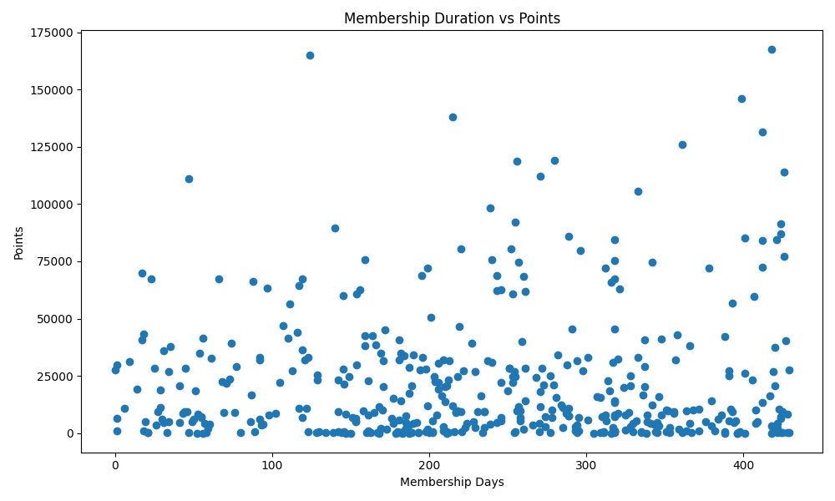
CLICKS LOYALTY ANALYTICS
Regression Baseline
A Linear Regression model was included as a numeric baseline for predicting loyalty score, not as the main production classifier.
10.689
0.581
RMSE on loyalty score
R2 score
Why use regression at all?
Classification predicts the member's loyalty segment. Regression estimates the continuous loyalty score. Keeping both tasks gives the project a fuller analytics view: one model supports segment decisions, and the other checks whether simple numeric predictors explain the score.
Figure 7. Membership duration compared with points
The R2 result shows that a linear model explains part of loyalty behavior, but the classification task needs tree-based models to capture more complex differences between customers.
Clicks Loyalty Customer Analytics System
14

Slide 16
CLICKS LOYALTY ANALYTICS
Data Cleaning and Validation
The project checks the dataset before modeling so the ranking is based on consistent customer records.
1
Column validation
Customer_Name, Username, Points, Birthday, and Member_Since are required.
2
Text cleanup
Names and usernames are stripped so duplicates are not hidden by spacing.
3
Numeric points
Points are converted to numeric values and invalid negative entries are handled.
4
Duplicate removal
Repeated records are removed before feature engineering and modeling.
0
446
duplicate rows in final run
records modeled
Clicks Loyalty Customer Analytics System
15

Slide 17
CLICKS LOYALTY ANALYTICS
Feature Engineering Detail
The code creates behavioral features that make the model more informative than using points alone.
Membership Days
Age
How long the member has been enrolled.
Customer age derived from birthday.
Log Points
Percentile Rank
Compresses extreme point values while keeping rank order.
Shows where a customer sits compared with the full dataset.
Points per Day
Points per Month
Measures activity speed over the membership period.
A more readable monthly velocity feature.
Feature engineering is the bridge between a raw loyalty file and a model that can recognize different forms of customer value.
Clicks Loyalty Customer Analytics System
16

Slide 18
CLICKS LOYALTY ANALYTICS
Ranking Formula Detail
The score is designed to reward both total value and engagement speed while keeping the ranking explainable.
Points
35%
Log Points
20%
Percentile
20%
Points / Day
15%
Membership Days
10%
Final ranking
After the score is calculated, customers are sorted from highest to lowest score and assigned Loyalty_Rank values starting from 1.
Clicks Loyalty Customer Analytics System
17

Slide 19
CLICKS LOYALTY ANALYTICS
Classification Experiment Design
The classification task predicts loyalty segment using the engineered customer features.
Features
Models
Target
Membership_Days
Age
Log_Points
Percentile_Rank
Points_Per_Day
Points_Per_Month
Decision Tree
Random Forest
Gradient Boosting
Customer_Segment
based on loyalty score thresholds
The models are compared on the same data split and metrics. This makes the winner meaningful because it is based on controlled evaluation rather than a single isolated score.
Clicks Loyalty Customer Analytics System
18

Slide 20
CLICKS LOYALTY ANALYTICS
How the Metrics Are Read
The evaluation uses several metrics because each one answers a different question about prediction quality.
Accuracy
Balanced Accuracy
How many total predictions were correct.
How well the model performs across classes, not only the largest class.
Precision
Recall
How reliable a predicted segment is when the model chooses it.
How many true members of a segment the model finds.
F1 Score
Macro F1
The balance between precision and recall.
Average F1 across classes with equal class importance.
Metric choice
Gradient Boosting wins because it performs best across the full metric set, not because of only one number.
Clicks Loyalty Customer Analytics System
19

Slide 21
CLICKS LOYALTY ANALYTICS
Generated Outputs
The system creates files that can be reviewed after the script runs, making the analysis reproducible.
Data Outputs
Model Outputs
Charts
summary_statistics.csv
segment_summary.csv
cluster_profile.csv
segmented_customers.csv
classification_model_comparison.csv
gradient_boosting_metrics.csv
linear_regression_metrics.csv
feature importance files
points histogram
segment visuals
feature importance
confusion matrices
top loyal customers
This separation is important: charts support presentation, CSV files support checking, and model outputs support comparison.
Clicks Loyalty Customer Analytics System
20

Slide 22
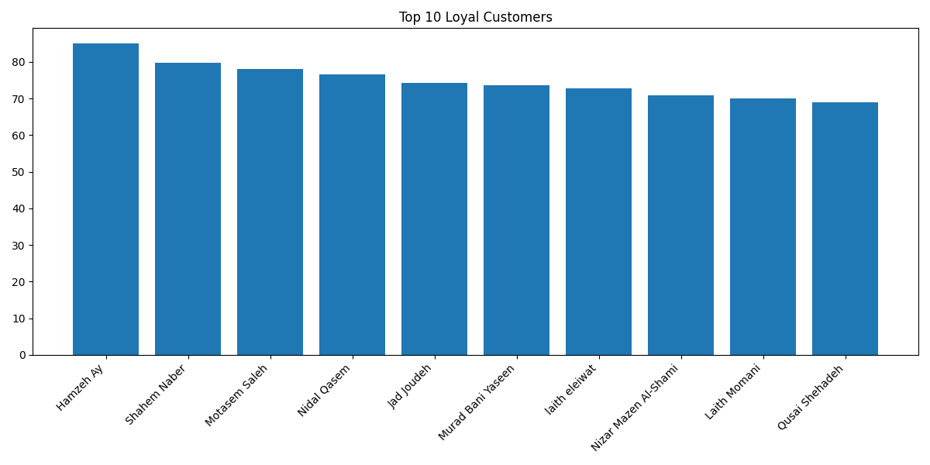
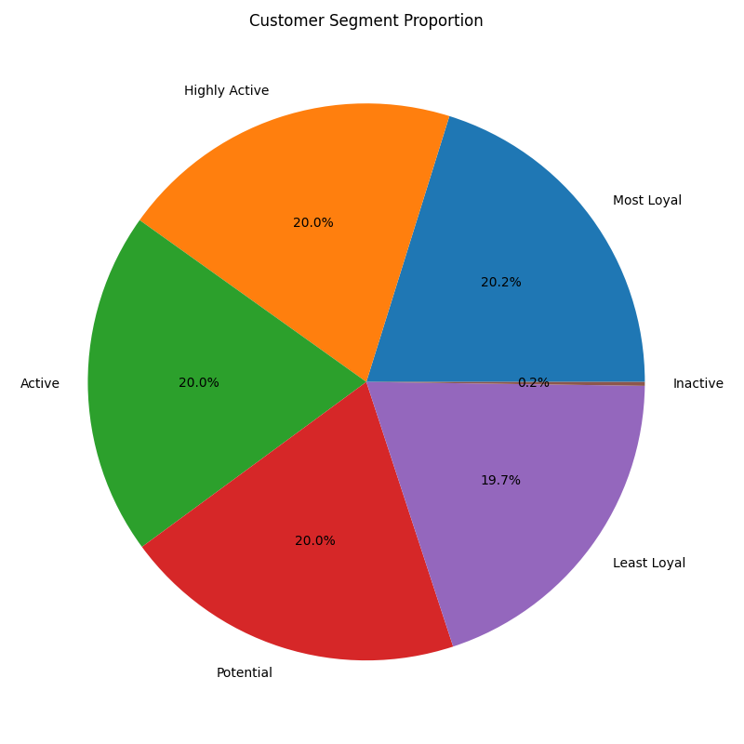
CLICKS LOYALTY ANALYTICS
Visual Findings
The charts show the same pattern from different angles: loyalty value is concentrated, but there are clear growth groups.
Figure 8. Top 10 loyal customers
Figure 9. Segment mix
Top customers have much higher loyalty scores, so retention should prioritize them first.
The segment mix creates enough members in most groups for meaningful comparison.
The distribution suggests a classic loyalty pattern: many moderate members and fewer very high-value members.
Clicks Loyalty Customer Analytics System
21

Slide 23
CLICKS LOYALTY ANALYTICS
Business Recommendations
The analytics output should be turned into member actions, not left as model scores only.
Most Loyal and Cluster 3
VIP treatment, early access, and personal recognition.
Protect
Highly Active and Active
Point multipliers, basket-building offers, and category bundles.
Grow
Potential
Clear next-step missions and low-friction onboarding rewards.
Convert
Least Loyal and Inactive
Small win-back offers, then measure response before deeper discounting.
Reactivate
Campaign logic
The ranking tells who matters most; the segment tells what message they should receive.
Clicks Loyalty Customer Analytics System
22

Slide 24
CLICKS LOYALTY ANALYTICS
Limitations and Future Work
The system is strong for the project scope, but richer transaction history would make it more realistic for production.
Limitation
The dataset is member-level, not transaction-level, so it cannot measure exact purchase frequency or basket value.
Future Work
Use cross-validation and time-based validation when real customer history becomes available.
Future Work
Add transaction history, campaign responses, category preferences, and store/channel behavior.
Clicks Loyalty Customer Analytics System
23

Slide 25
CLICKS LOYALTY ANALYTICS
Final Conclusion
The final project is a complete loyalty analytics workflow with realistic data, documented logic, and model-backed business recommendations.
Best Model
Best Use
Best Next Step
Gradient Boosting is selected because it leads the comparison on accuracy, balanced accuracy, and F1.
The ranked customer list and segments should drive retention, growth, and reactivation campaigns.
Add real transaction history to improve validation and make the model closer to production.
Main takeaway: the model matters, but the full decision structure matters more: clean data, clear score logic, practical segments, and explainable outputs.
Clicks Loyalty Customer Analytics System
24

